Slide 1
Embedded Hands On Training
Connected Apps and Embedding API v3

Slide 2
Lesson 1 : Basic Embed

Slide 3
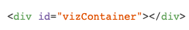
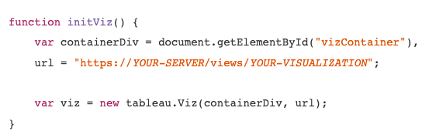
The Old Way
1. Enable the API:
2. Create a DIV object in your HTML:
3. Write a function to display the viz:

Slide 4
The New Way
1. Enable the API:
<script type="module" src="https://public.tableau.com/javascripts/api/tableau.embedding.3.latest.min.js"></script>
2. Add a TABLEAU VIZ WEB COMPONENT!
<tableau-viz id='tableauViz' src='http://my-server/views/my-workbook/my-view'
device='phone' toolbar='bottom' hide-tabs> </tableau-viz>

Slide 5
Lesson 2 : Connected Apps

Slide 6
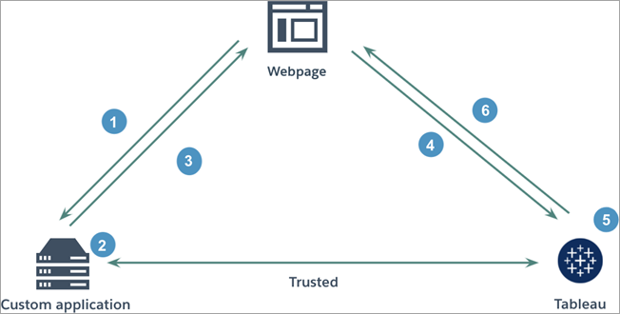
What?
Connected Apps
New authentication method available for Tableau Cloud and Tableau Server
Uses a more modern approach to achieve seamless and secure SSO via JWT (shared secret)
Similar to Trusted Tickets. Works with virtually any web-auth flow but without the need for IP whitelisting
Additional scoping options available

Slide 7
Lesson 3 : Advanced Integration

Slide 8
The Viz Object
Contains everything about our “Embed”
Point of entry to our Embedded content
Can be queried for info
Properties can be set
Has methods so we can perform actions
Register event handlers

Slide 9
The Viz Object
Viz
Workbook
Sheets
Dashboard
Worksheet
Story
Filters

Slide 10
Getting the Viz Object
Seen in in Part 1 with the Reset/Undo/Redo
Grab it when the page loads
window.onload()
When Tableau loads
“firstinteractive”

Slide 11
Setting properties
We can dynamically set properties
<tableau-viz id="tableauViz"
src= "{{tabServer +/views/Sales/SalesDashboard'}}"
device="mobile"
toolbar="top"
hide-tabs
width=100%>
</tableau-viz>
viz.src = "http://myserver:port/views/workbook/view"

Slide 12
Lesson 3_1 : Multi Viz

Slide 13
Filtering
Can be applied initially or after loading the content
Categorical, Range, Date types
Applied to a “worksheet” type “sheet”
May need to loop around our “dashboard”
Example in Tableau

Slide 14
Lesson 3_2_1 : Static Filters

Slide 15
Filter Data
We can pull from Tableau the data
Create our own dynamically generated filters
Get the entire domain, not just applied values!
Big improvement on API v2

Slide 16
Lesson 3_2_2 : Dynamic Filters

Slide 17
Selections
When you click, or drag on a Tableau viz
It can trigger other events to happen
We can apply these from the app
Like filtering, applied to a “worksheet”
similar looping ideas

Slide 18
Lesson 3_3 : Select Marks

Slide 19
Event Listeners
App has knowledge something happened in Tableau
Pull data from the event to drive action
Completes the 2 way communication
Seen already - “firstinteractive”
Filter changed, selections made, size known

Slide 20
Lesson 3_4 : Get Marks

Slide 21

We hope we’ve blown your mind…
…with the endless possibilities when you embed Tableau!

Slide 22
Lesson 4: Full Solution

